Slide 1


GOLD BOND or GENERAL BONDS

Slide 2
Introduction
Investment
An investment is an asset or item acquired with the goal of generating income or appreciation. Appreciation refers to an increase in the value of an asset over time.
"Investing" we mean buying an asset for making a profit by selling it in the future, after it appreciates in value.
GOLD BOND
GENERAL BONDS

Slide 3


Project Goal
Finding the best investment between Gold Bond and General Bonds by building a forecasting model.
Objectives
Constraints
Maximize the Investment returns
Minimize the Investment risk

Slide 4
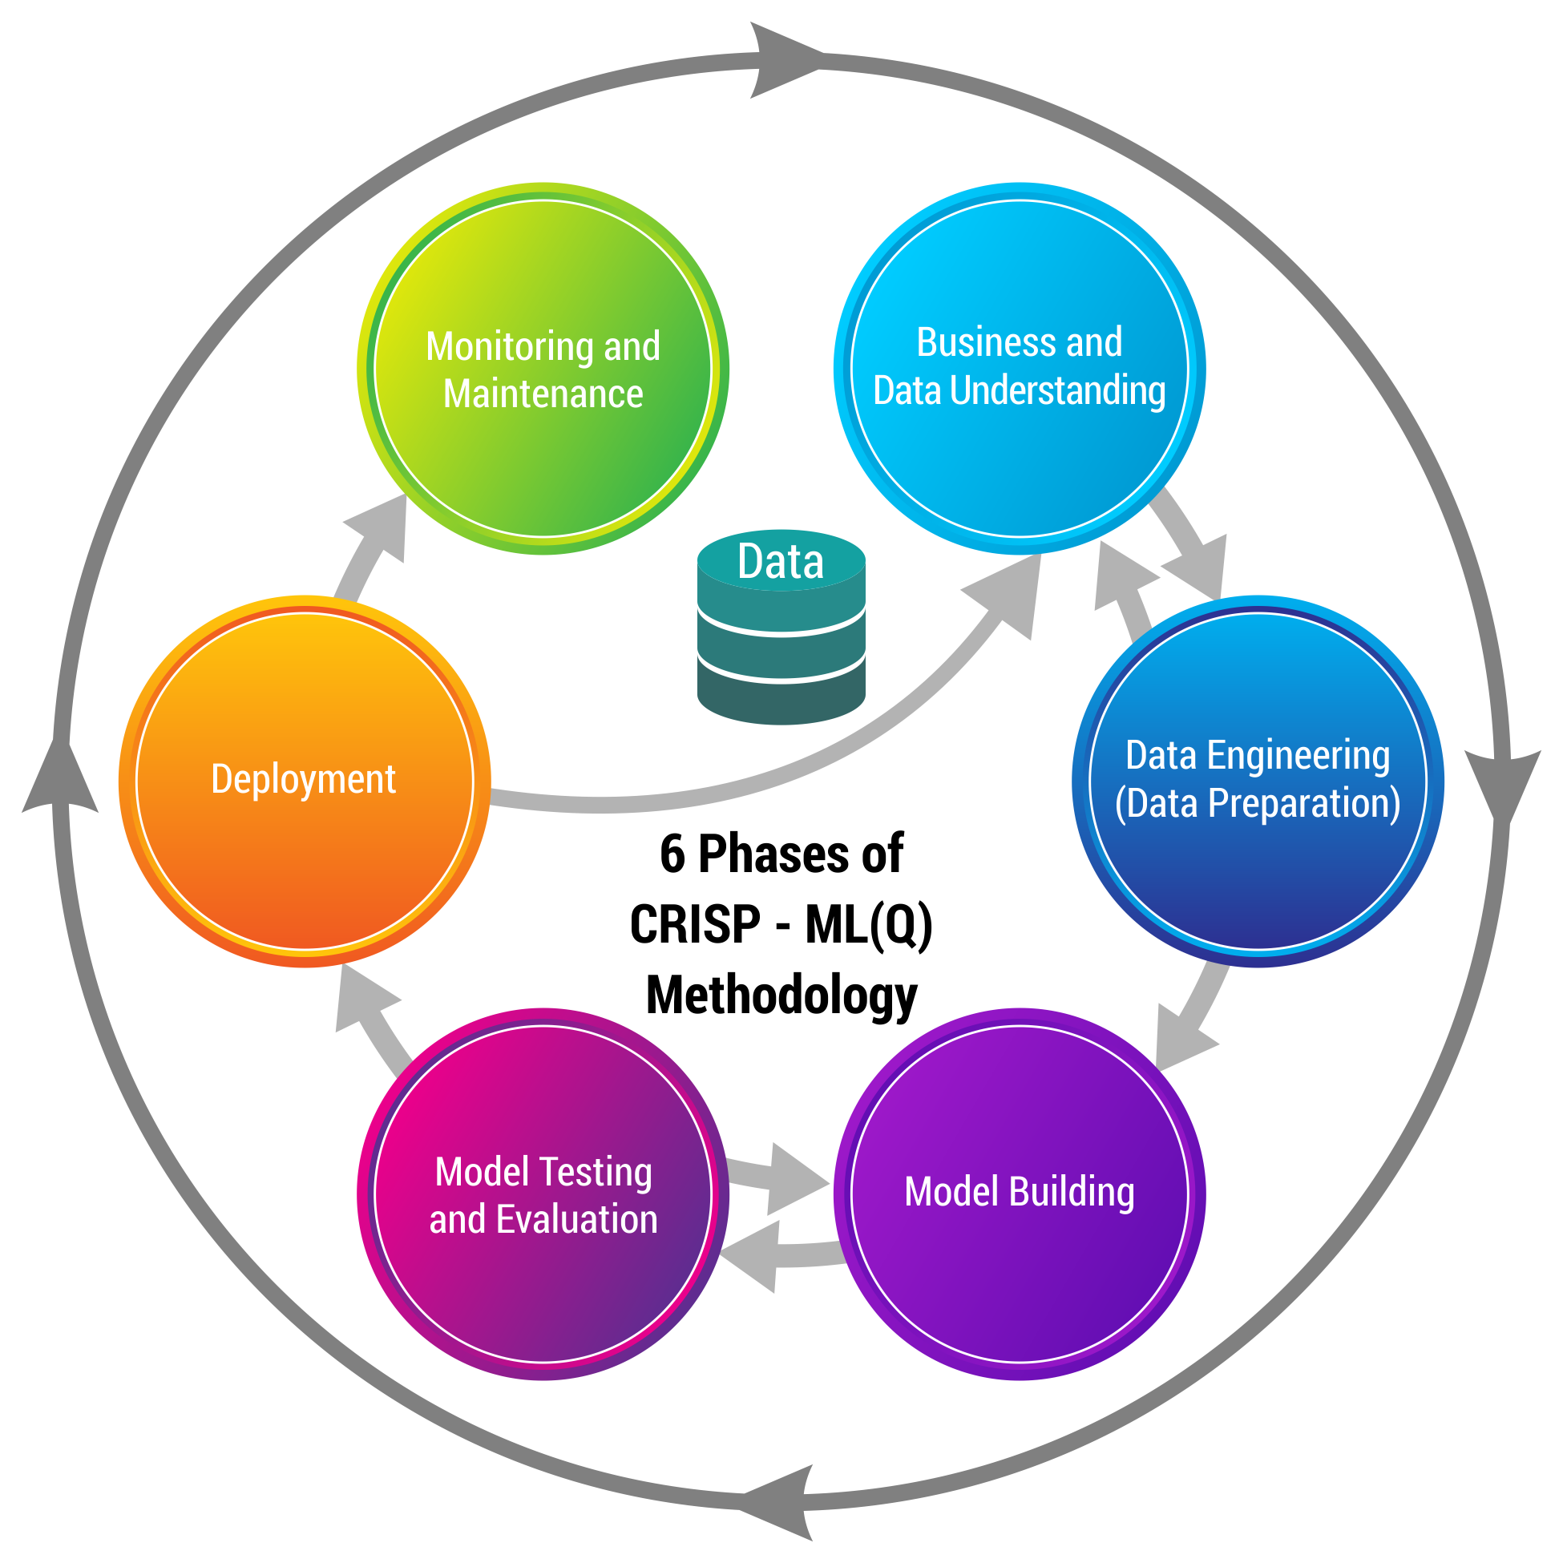
Business pipeline: CRISP-ML(Q) Methodology

Slide 5









Technical Stacks

Slide 6
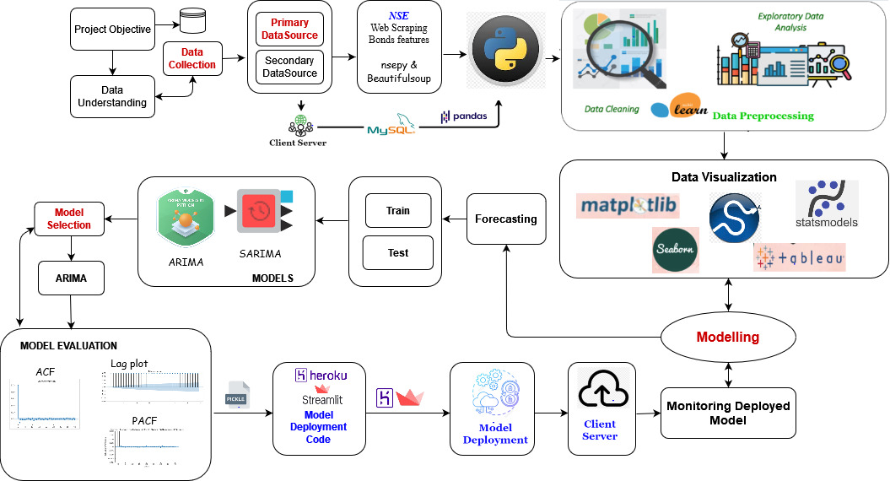
Project Architecture / Data Pipeline

Slide 7

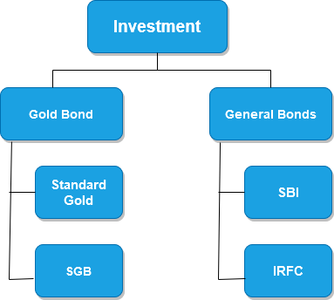
Data Collection
 | Data Sources
Standard Gold | https://www.livechennai.com/get_goldrate_history.asp
SGB | https://www.topsharebrokers.com/report/sovereign-gold-bond-return-calculator/317/
SBI | https://in.investing.com/funds/sbi-life-bond-fund-historical-data?end_date=1632162600&st_date=1313951400
IRFC | https://www1.nseindia.com/products/content/equities/equities/eq_security.htm

Slide 8
Sovereign GOLD Bond
They are substitutes for holding physical gold. Investors have to pay the issue price in cash and the bonds will be redeemed in cash on maturity. The Bond is issued by Reserve Bank on behalf of Government of India.
Benefits
Who can Invest in ?
Minimum investment in the Bond shall be one gram with a maximum limit of subscription of 4 kg for individuals.
- No GST when purchase
- No Making Charges
- Assured Returns of 2.5% P.A
- No Worry for Storage
- No Capital Gain Tax on Redemption
- Minimum 1 gram investment
- Individuals
- HUFs
- Education Institutions-Universities
- Charitable organizations and trusts

Slide 9
Data Understanding for SGB
Data Source: Primary Data
Dataset shape: 2474 observations, 3 features
Name of Feature | Description
Date | Date format(YYYY/MM/DD)
Price | 24 karat physical gold price
Price | 22 Carat Standard gold

Slide 10

Data Processing for Standard Gold/SGB
Initial dataset was having rows 2474 and 3 columns.
Following steps were taken to perform Exploratory Data Analysis using Python:
Checked existence of NULL values, resulted in no “NA” value present.
Selected 2 features (Date and Price) which would help to accomplish our purpose.
Filled missing “Dates” in data set and “Pure Gold Prices” filled by Filled the missing dates in the data set and price was filled by using forward fill imputation.
Final data set has 2496 rows and 2 columns.
Checked Correlation using pair-plot and also checked seasonality.

Slide 11
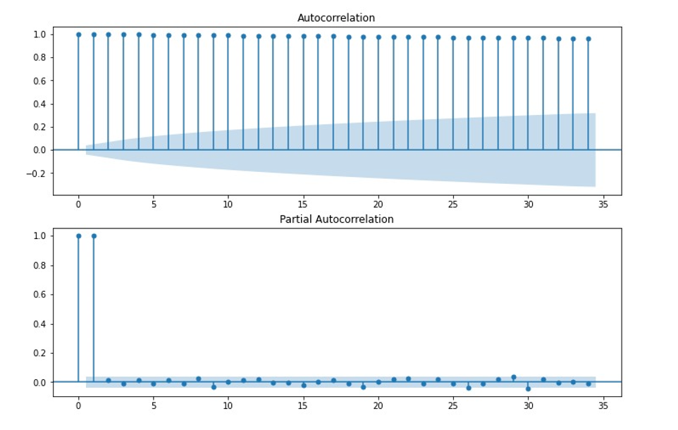
EDA - Standard Gold/SGB
Here this plots are of Autocorrelation and Partial Autocorrelation which gives us the values for the hyperparameter which is P & Q.

Slide 12
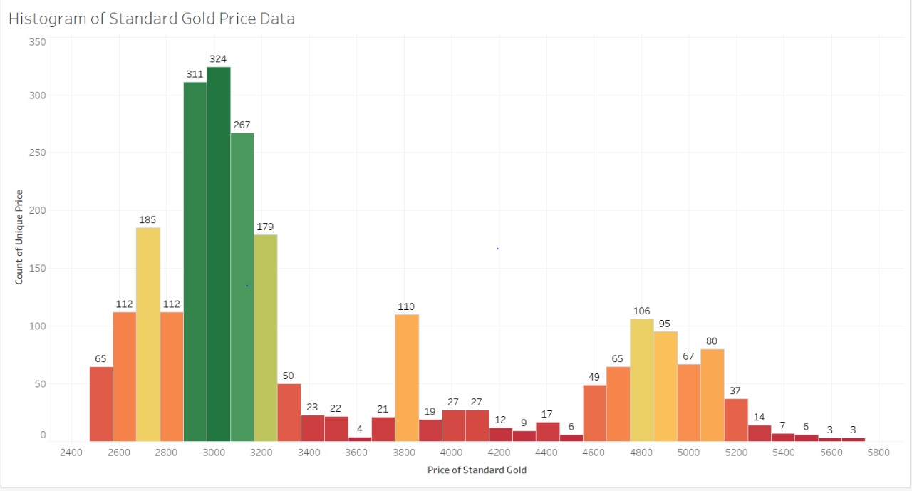
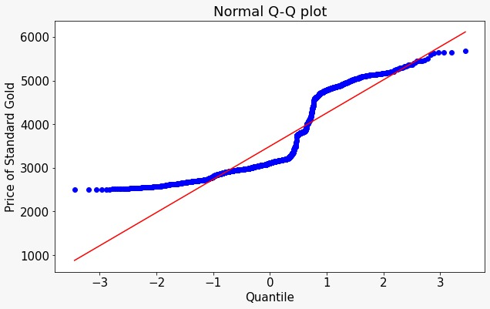
EDA – Standard Gold
Fig: Histogram representation
Fig: Q-Q plot representation
Data is not normally distributed and observed most data lies between 2400 to 3600.
It show the positive uptrend of the asset class with sustainable growth through pertinent quarters.

Slide 13
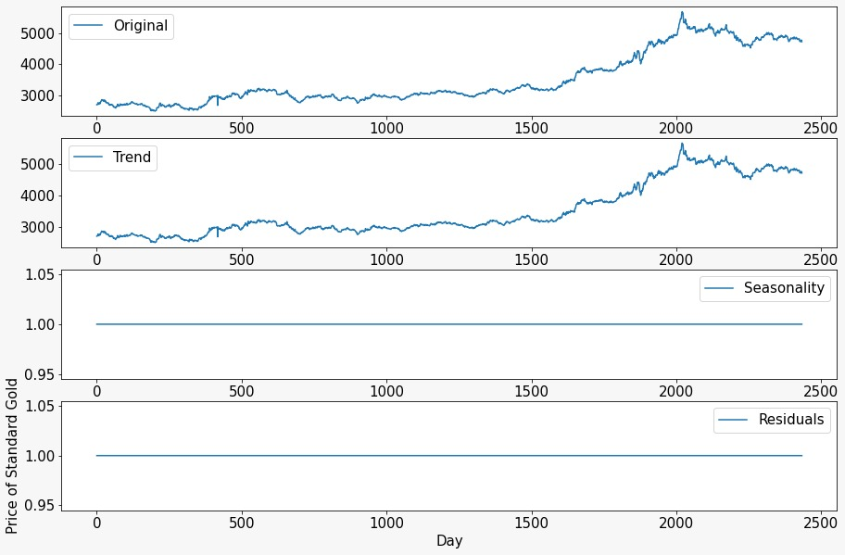
EDA – Standard Gold
In this graph, the data is showing upward trend and there is no seasonality in the data.
Fig: Seasonality Graph

Slide 14
GENERAL BONDS
A Bond is loan from an investor to a borrower such as a company or government. The borrower uses the money to fund its operations, and the investor receives interest on the investment. The market value of a bond can change over time.
Key Facts
Pros | Cons
Relatively safe | Low interest rates
Create a balancing force in portfolio | Difficulty in selling the bond you own
A form of fixed-income | Inflation can also reduce your purchasing power over time
Pay interest at regular, predictable rates and intervals.
Solid asset
Average returns
Risks

Slide 15
Data Understanding for SBI
Data Source: Primary Data
Dataset shape: 797 observations, 6 features
Name of Feature | Description
Date(Index) | Date format(YYYY/MM/DD)
Open / Price | Opening price of the bond
High | Highest Price of the bond
Low | Low Price of the bond
Close | Closing price of the bond
Change Pct | Change in the Open Price of Present-Day Price and Close Price of Previous day Price

Slide 16

Data Processing for SBI
Initial dataset was having 797 rows and 6 columns.
Following steps were taken to perform Exploratory Data Analysis using Python:
Checked existence of NULL values, resulted in no “NA” value present.
Selected 2 features( Date, Price: Close) which would help to accomplish our purpose.
Filled the missing dates in the data set and price was filled by using forward fill imputation.
Final data set has 1204 rows and 2 columns.
Checked Correlation using pair-plot and also checked seasonality.

Slide 17
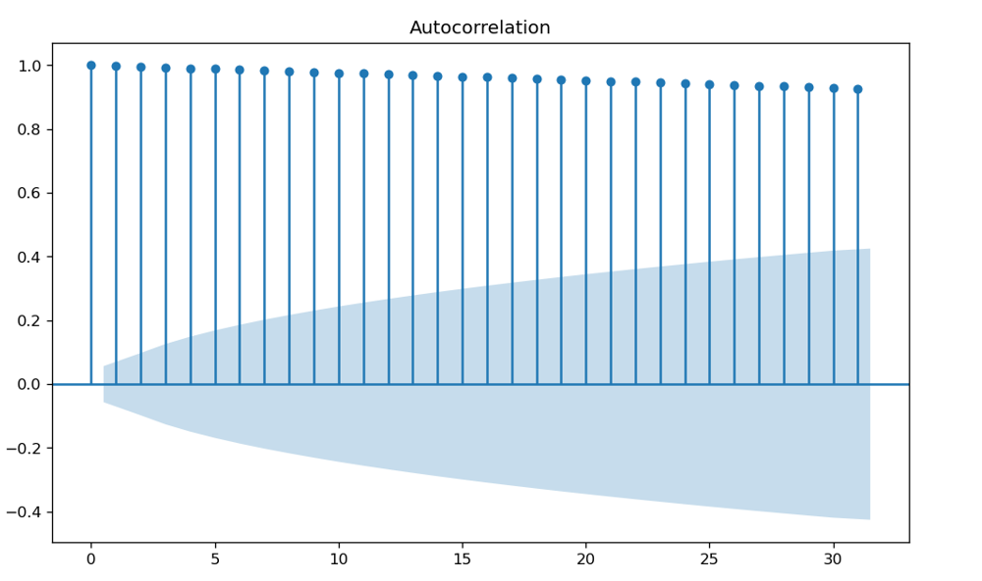
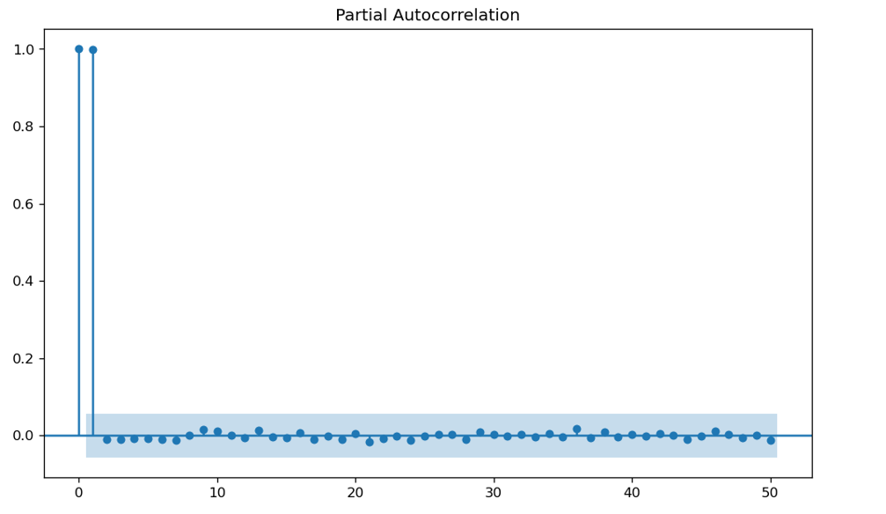
EDA - SBI
The above plot shows the Autocorrelation and Partial Autocorrelation which clearly displays the sudden steep from x=0 to 1. Based on these changes, we have chosen the hyper parameter as P = 1, Q = 0.

Slide 18
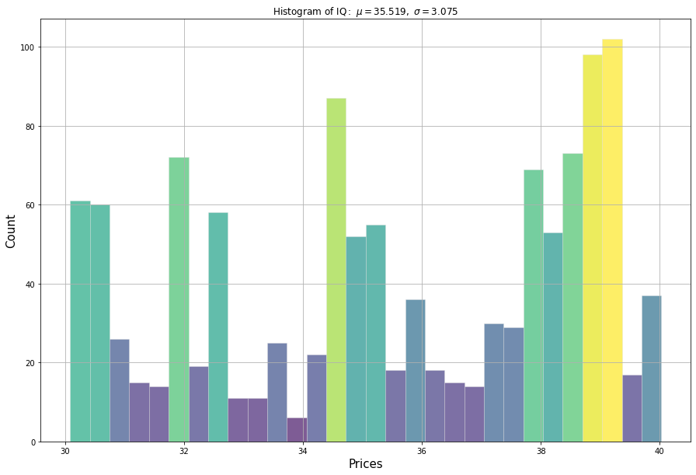
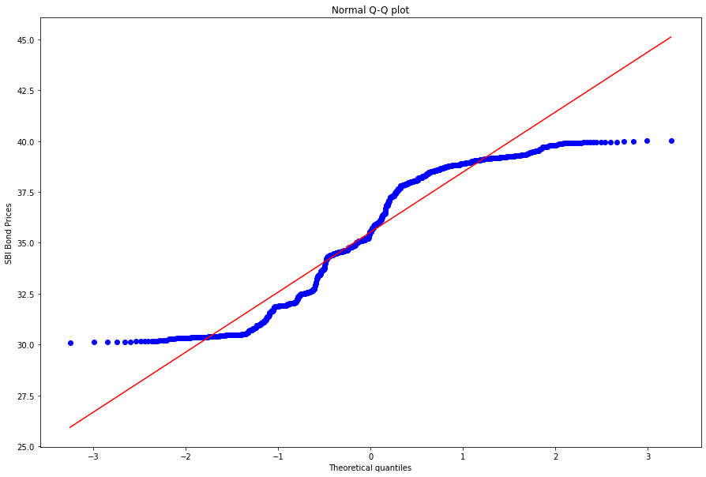
EDA - SBI
Fig: Histogram representation
Fig: Q-Q plot representation
The price action is observed to be sinusoidal in nature with the maximum price observed between 30 to 40.
The Q-Q plot explains the normality of the data and also displays few outliers which will not be affecting the data.

Slide 19
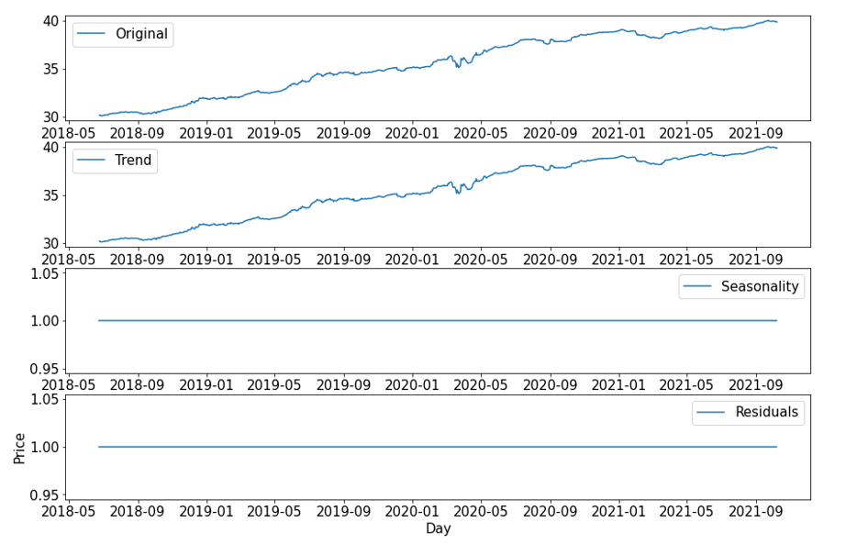
EDA - SBI
The variation in price action seems to be in an uptrend, without an effect of seasonality. This shows stability and positive market.
Fig: Seasonality Graph

Slide 20
Data Understanding for IRFC
Data Source: Secondary Data
Dataset shape: 1596 observations, 8 features
Name of Feature | Description
Date (Index) | Date format(YYYY/MM/DD)
Prev. Close(Price) | Closing price of the bond
Open | Opening price of bond
High | Highest price of bond reached for particular date
Low | Lowest price of bond reached for particular date
Last | Last price for the day
Close | Closed price for the day
VWAP(Avg) | Average of above features

Slide 21
Data Processing for IRFC
Following steps were taken to perform Exploratory Data Analysis in Python:
Checked existence of NULL values, resulted no “NA” value present.
Selected 2 features(Date, Price: Close) with the help of Correlation plot to accomplish our purpose.
Filled missing “Dates” in dataset and “Price” was filled by using forward imputation.
Final data set has 2473 rows and 2 columns.
Checked Correlation using pair-plot and also checked seasonality.

Slide 22
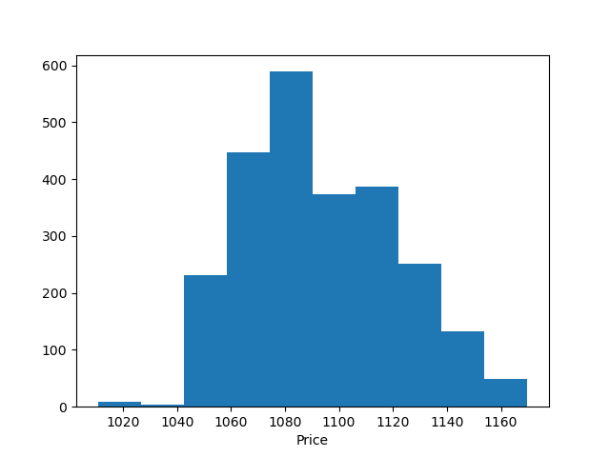
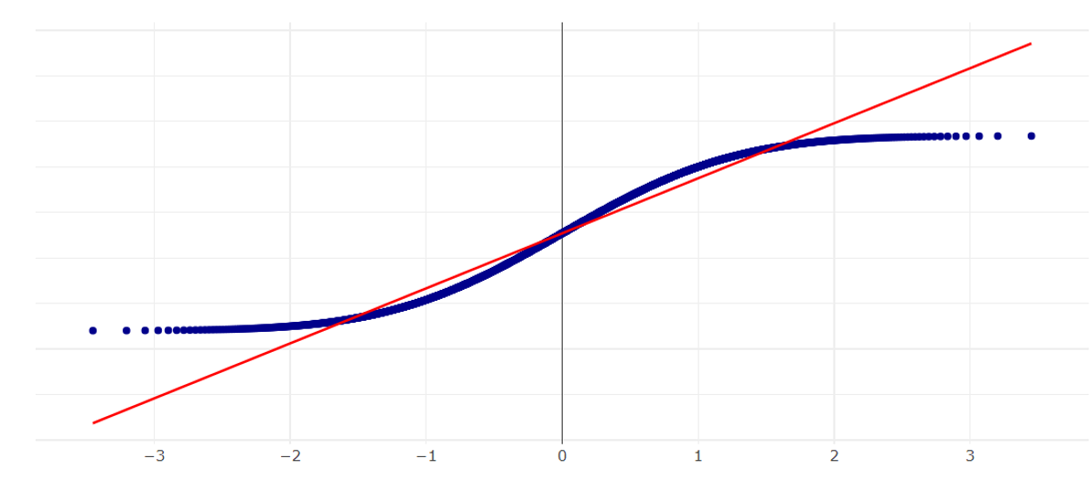
EDA - IRFC
Histogram representation of Price over last 5 years. Right skewness is observed.
Fig: Histogram representation
QQ-Plot displays a normal distribution of the Price variable with few outliers which are not affecting our dataset.
Fig: Q-Q plot representation

Slide 23
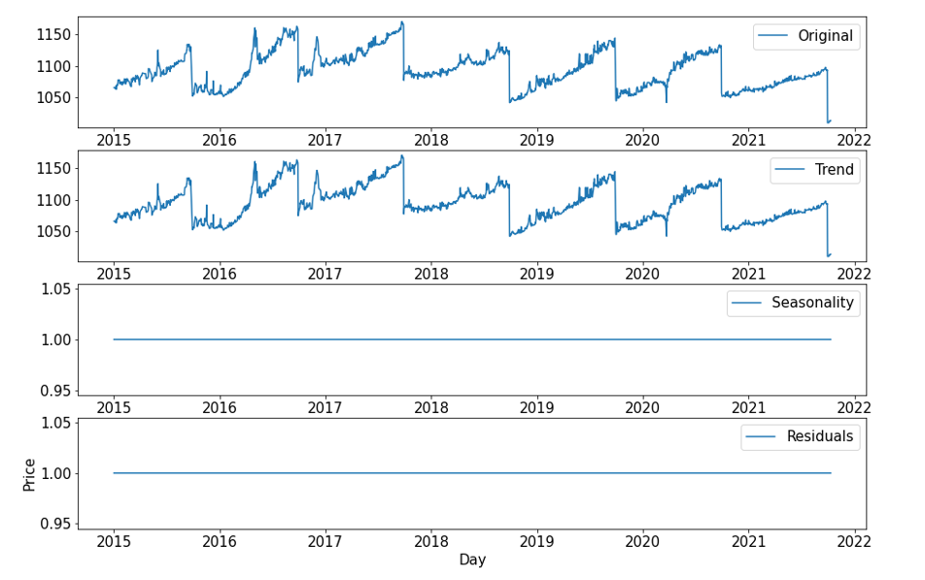
EDA - IRFC
Multiplicative Seasonality
Fig: Seasonality Graph
The above plot shows the negative trend with no seasonality.

Slide 24
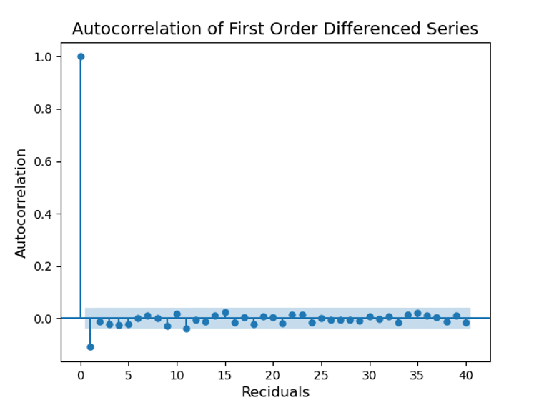
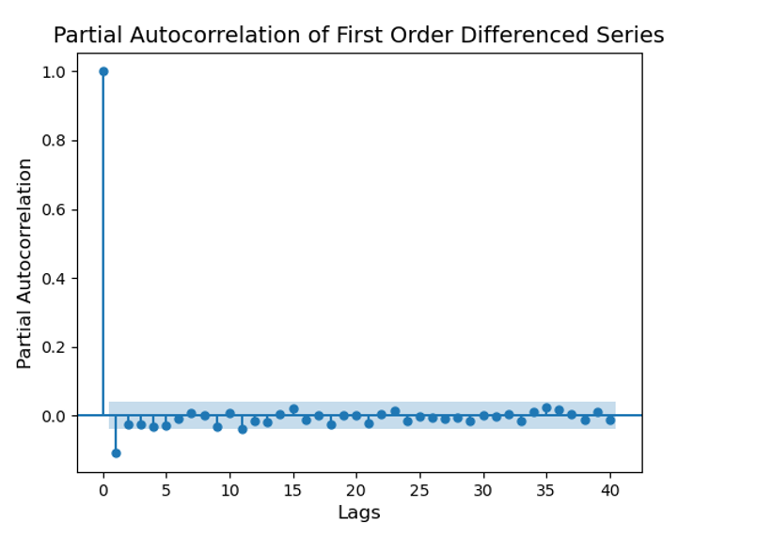
EDA - IRFC
The above plot shows the Autocorrelation and Partial Autocorrelation which clearly displays the sudden steep from x=0 to 1. Based on these changes, we have chosen the hyper parameter as P & Q = 1.

Slide 25

Model Building

Slide 26
Model Building
Autoregressive Integrated Moving Average Model:
This acronym is descriptive, capturing the key aspects of the model itself. Briefly, they are:
AR: Autoregression. A model that uses the dependent relationship between an observation and some number of lagged observations.
I: Integrated. The use of differencing of raw observations (e.g. subtracting an observation from an observation at the previous time step) in order to make the time series stationary.
MA: Moving Average. A model that uses the dependency between an observation and a residual error from a moving average model applied to lagged observations.
The parameters of the ARIMA model are defined as follows:
p: The number of lag observations included in the model, also called the lag order.
d: The number of times that the raw observations are differenced, also called the degree of differencing.
q: The size of the moving average window, also called the order of moving average.

Slide 27
Model Description
Data | SGB (Pure Gold) | SBI | IRFC
(p, d, q) | (2, 1, 2) | (1, 1, 0) | (1,0,1)
Selection Process | auto_arima using pmdarima library | auto_arima using pmdarima library | Stationary check was conducted with Adfuller test using statsmodels library. Data is stationary, hence d = 0 p value was confirmed with autocorrelation plot. q value was confirmed with partial autocorrelation plot.

Slide 28
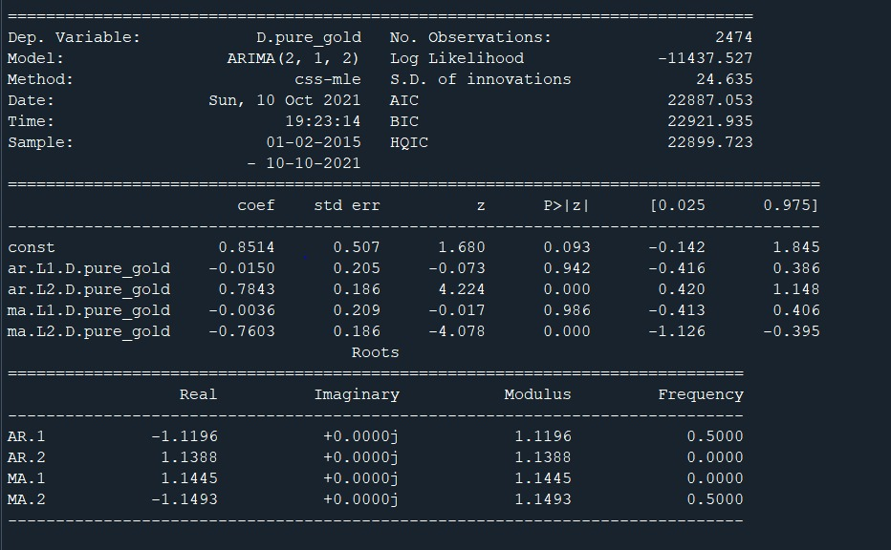
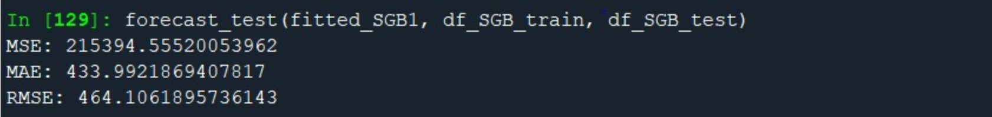
Outputs of the Model in Codes
SGB

Slide 29
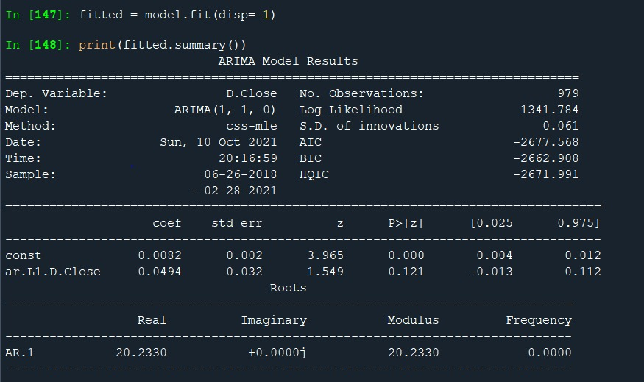
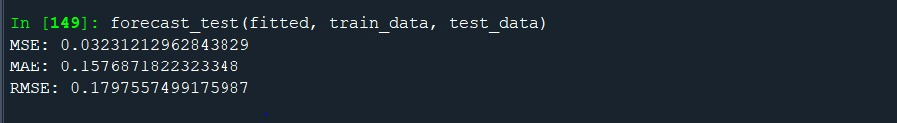
Outputs of the Model in Codes
SBI

Slide 30
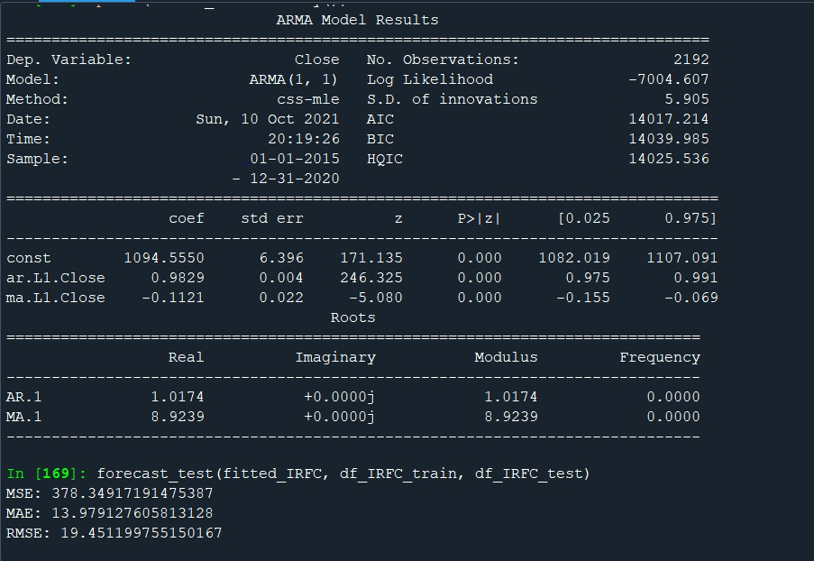
Outputs of the Model in Codes
IRFC

Slide 31
Comparison of Model Performance
Models | Model 1- SGB | Model 2-SBI | Model 3-IRFC
Accuracy | Medium | High | High
Returns (8 Years) | 82.64% | 111.51% | 11.09%

Slide 32


Deployment Strategy
Streamlit Features:
Streamlit has been used in this project for building the web application
No front-end programming experience required
Easy to deploy
Compatibility with all major frameworks/libraries
Heroku Features:
Support for modern open source languages
Trusted application operations
Built for continuous integration and delivery
Simple horizontal and vertical scalability

Slide 33
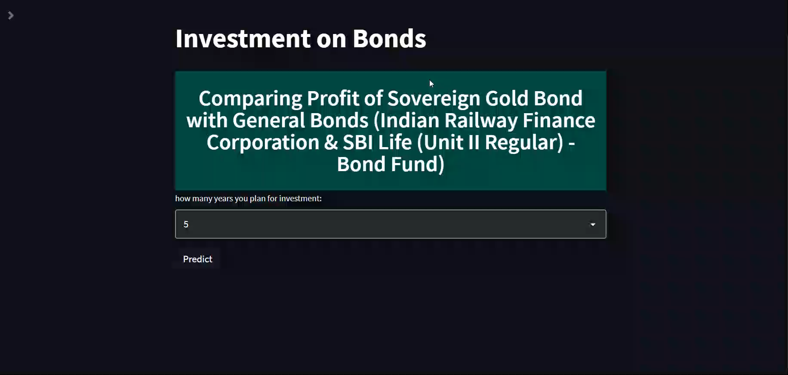
Let’s see how it works
https://compare-bonds.herokuapp.com/

Slide 34
Conclusion
SBI Life (Unit II Regular) - Bond Fund is giving almost 111.51% of profit percentage for next 8 years (2021-29), this is the highest amongst all the 3 investments.
As per SBI Life Insurance risk factor for SBI Life (Unit II Regular) - Bond Fund is Low to Medium.
Indian Railway Finance Corporation is giving almost 11.09% of profit percentage for next 8 years (2021-29). This is the lowest amongst all the 3 investments, and risk factor is High.
Sovereign Gold Bond is giving almost 82.64% of profit percentage for next 8 years (2021-29)., and risk factor is Low to Medium.
As per our observations, we recommend SBI Life (Unit II Regular) - Bond Fund for investment, it’s giving highest profit with low risk factor.

Slide 35
Future Scope
Similar implementation techniques could be applied to multiple company bonds (eg: Reliance, Tata).
Data if provided by the client would help in understanding the requirements of the client and enhance the model performance Model improvisation will result in better accuracy.
Deep diving into feature which may add value to the project and improve accuracy.
Tailor made options as per customer's needs could result in best investment and good returns.

Slide 36

